Slide 1
Checking Mesh Completeness

Slide 2
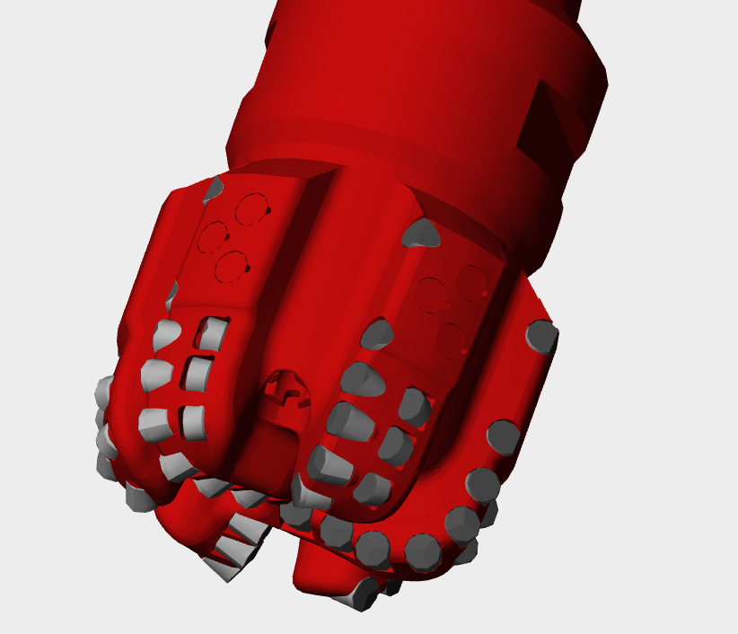
Checking Mesh Generation
Open bit XML file in bit simulator with no bit modification files
Check to make sure no cutter pieces are missing
If so, be sure all cutters are visible in Creo before exporting
Check to make sure all cutters are colored
If any is red, be sure they are appropriately tagged in Creo
Check to make sure all parts are rendered in the proper locations
If any is misplaced, this may be a bug in the mesher

Slide 3
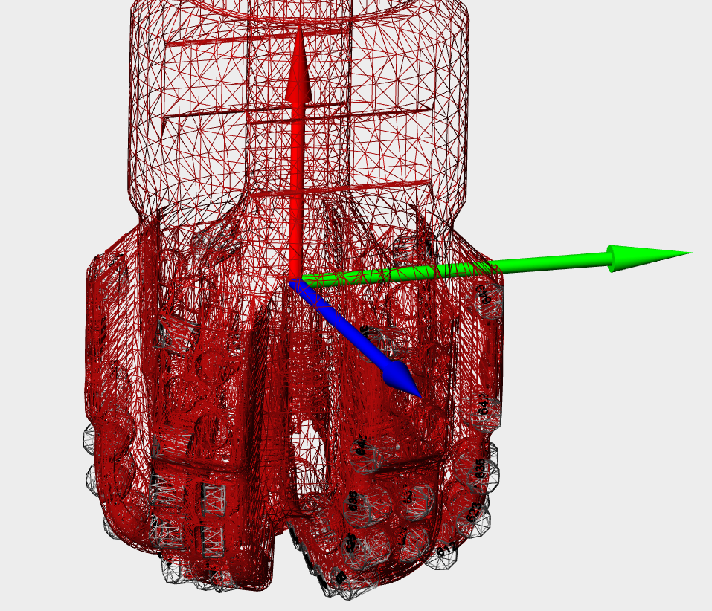
Check Bit Coordinate System
Turn on bit coordinate system axis
Be sure it is oriented correctly
Blue should be aligned with Blade 1
Turn on bit part labels to find Blade 1 (starts with lowest value cutter)
Red should be pointed toward bit pin

Slide 4
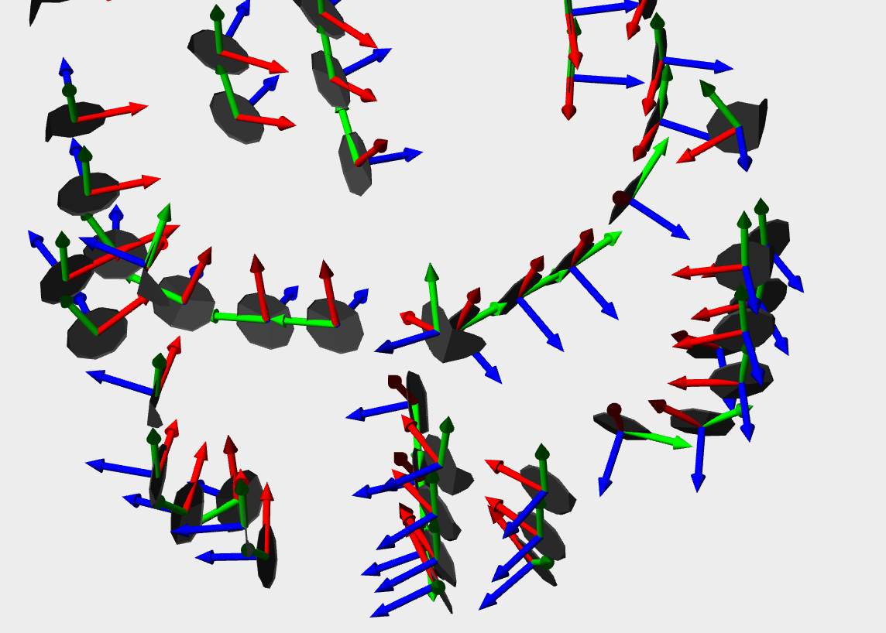
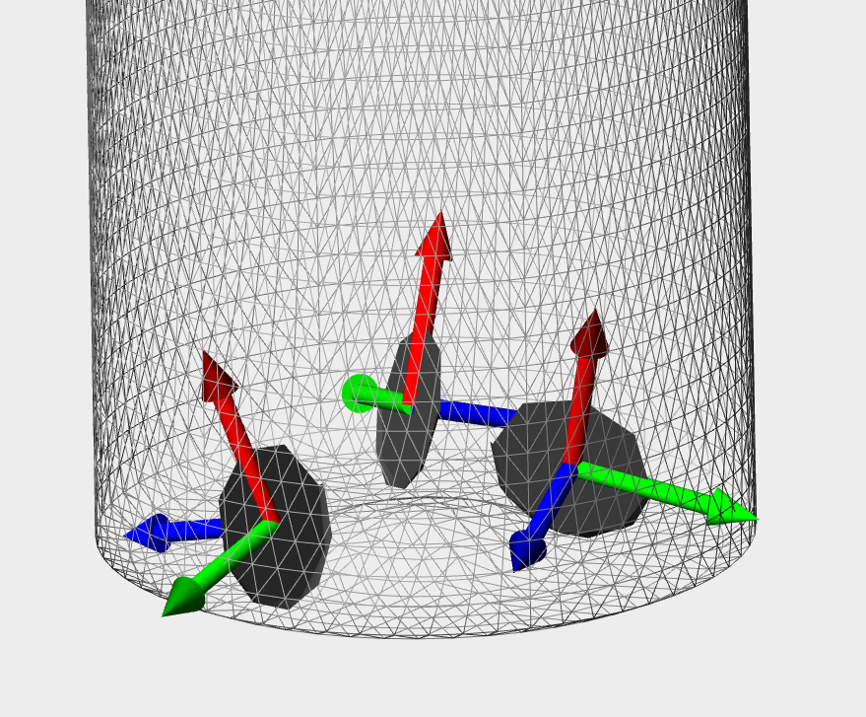
Check Bit Part Coordinate Systems
Open bit with modification file to delete all non-cutter elements
Turn on bit part coordinate system axes
Check to ensure origin is in center of part face
If not, DYNAMIC_CSYS may not be oriented correctly in Creo
Be sure axes are oriented correctly
Blue should be normal to part face pointed forward
Red should be pointed up away from cutter-rock contact point

Slide 5
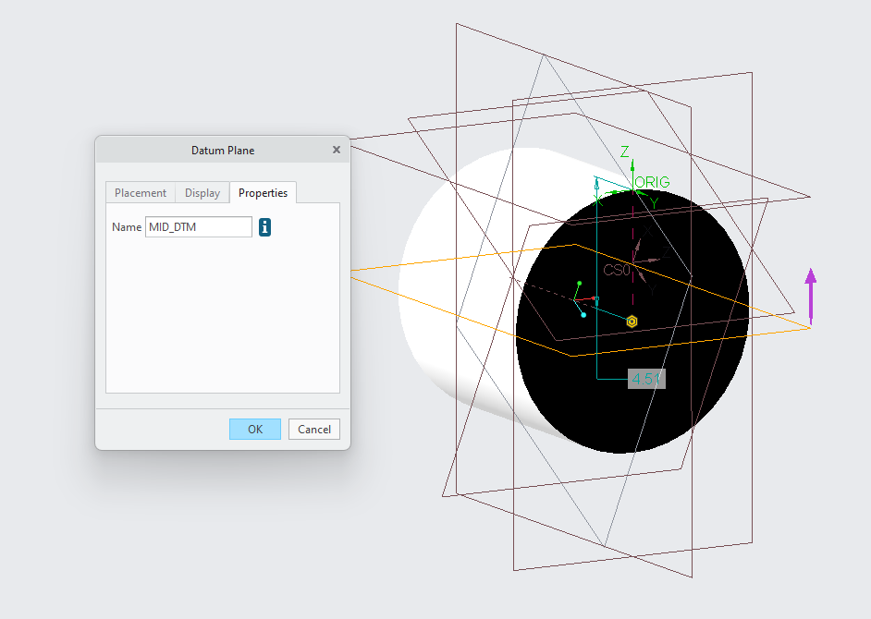
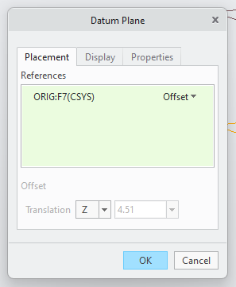

Slide 6
Last Slide

